Slide 1
Data Structures and Algorithms
B⁺ Trees II
Lecture 13:
Department of Computer Science & Technology
United International College

Slide 2
B+ Tree Review
A B+ tree of order M
Each internal node has at most M children (M-1 keys)
Each internal node, except the root, has between ⎡M/2⎤-1 and M-1 keys
Each leaf has between ⎡L/2⎤ and L keys and corresponding data items

Slide 3
Deletion
To delete a key target, we find it at a leaf x, and remove it.
Two situations to worry about, then:
The target is a key in some internal node (needs to be replaced, according to our convention)
After deleting target from leaf x, x contains less than ⎡L/2⎤ keys (needs to merge nodes)

Slide 4
Situation 1: Removal of a Key
The target can appear in at most one ancestor y of x as a key (WHY?)
Node y is seen when we searched down the tree.
After deleting from node x, we can access y directly and replace target by the new smallest key in x

Slide 5
Situation 2: Handling Leaves with Too Few Keys
Suppose we delete the record with key target from a leaf.
Let u be the leaf that has ⎡L/2⎤ - 1 keys (too few)
Let v be a sibling of u with at least ⎡L/2⎤+1 keys
Let k be the key in the parent of u and v that separates the pointers to u and v
There are two cases

Slide 6
Handling Leaves with Too Few Keys
Case 1: v contains ⎡L/2⎤+1 or more keys and v is the right sibling of u
Move the leftmost record from v to u
Case 2: v contains ⎡L/2⎤+1 or more keys and v is the left sibling of u
Move the rightmost record from v to u
Then set the key in parent of u that separates u and v to be the new smallest key in u

Slide 7
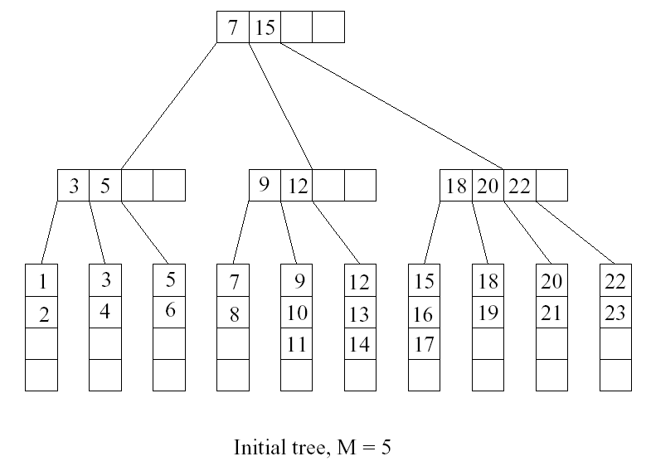
Deletion Example
L=4 M=5
Want to delete 15

Slide 8
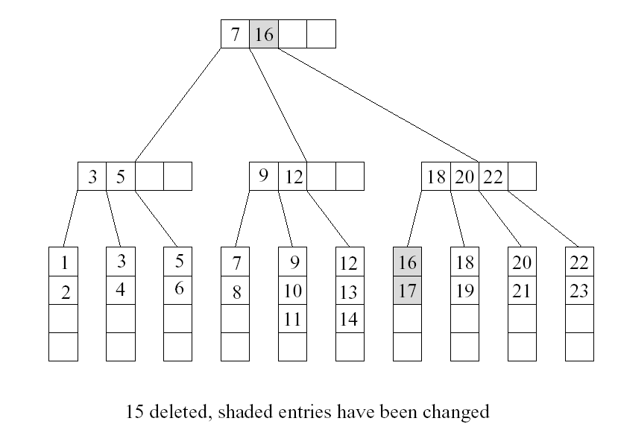
Deletion Example (Cont’d)
Want to delete 9

Slide 9
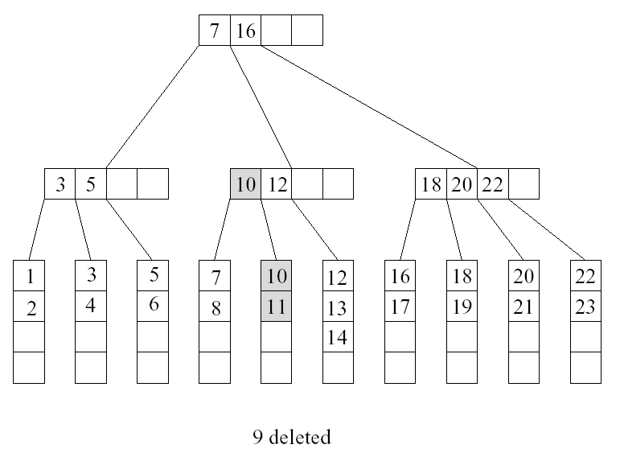
Deletion Example (Cont’d)
Want to delete 10, situation 1

Slide 10
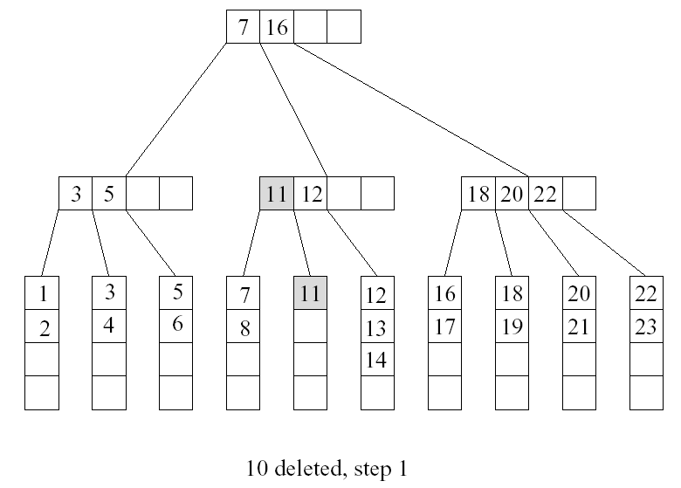
Deletion Example (Cont’d)
Deletion of 10 also incurs situation 2
u
v

Slide 11
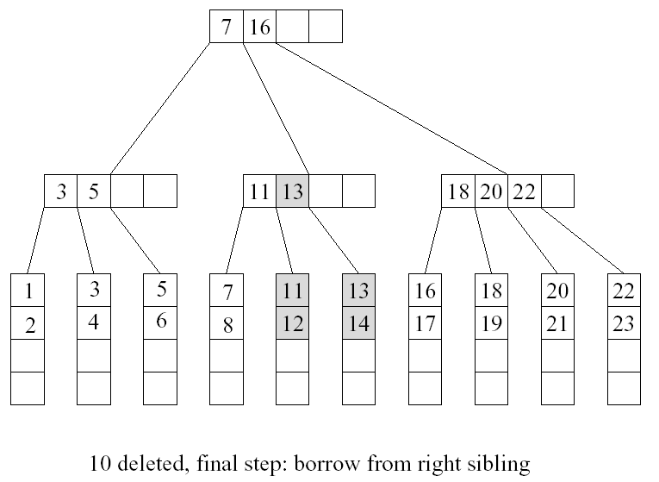
Deletion Example (Cont’d)

Slide 12
Merging Two Leaves
If no sibling leaf with ⎡L/2⎤+1 or more keys exists, then merge two leaves.
Case 1: Suppose that the right sibling v of u contains exactly ⎡L/2⎤ keys. Merge u and v
Move the keys in u to v
Remove the pointer to u at parent
Delete the separating key between u and v from the parent of u

Slide 13
Merging Two Leaves (Cont’d)
Case 2: Suppose that the left sibling v of u contains exactly ⎡L/2⎤ keys. Merge u and v
Move the keys in u to v
Remove the pointer to u at parent
Delete the separating key between u and v from the parent of u

Slide 14
Example
Want to delete 12

Slide 15
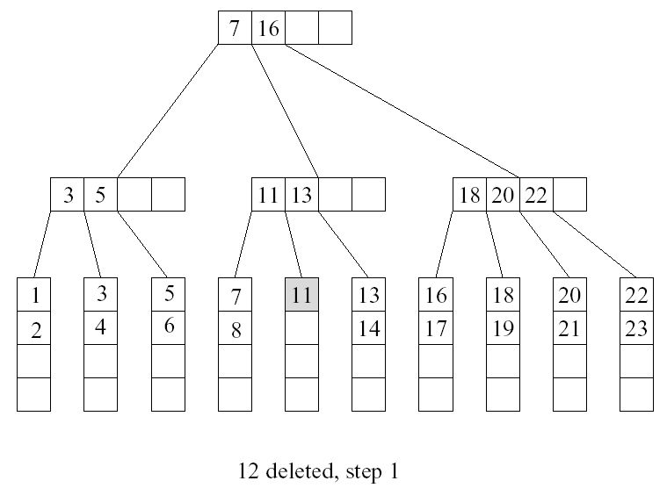
Example (Cont’d)
u
v

Slide 16
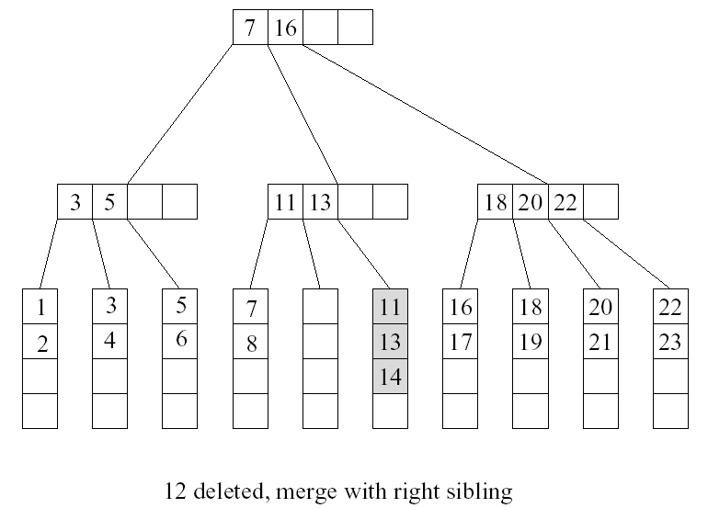
Example (Cont’d)

Slide 17
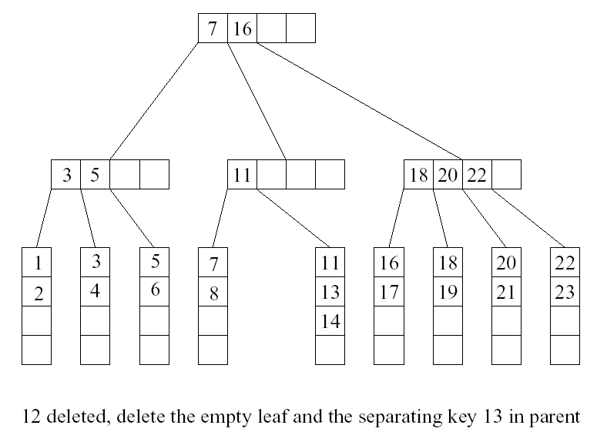
Example (Cont’d)
too few keys! …

Slide 18
Deleting a Key in an Internal Node
Suppose we remove a key from an internal node u, and u has less than ⎡M/2⎤ -1 keys after that
Case 1: u is a root
Thus u has only one child, then we remove u and make its child the new root

Slide 19
Deleting a key in an internal node
Case 2A: the right sibling v of u has ⎡M/2⎤ keys or more
Move the separating key between u and v in the parent of u and v down to u
Move the leftmost key in v to become the separating key between u and v in the parent of u and v.
Make the leftmost child of v the rightmost child of u
Case 2B: the left sibling v of u has ⎡M/2⎤ keys or more
Move the separating key between u and v in the parent of u and v down to u.
Move the rightmost key in v to become the separating key between u and v in the parent of u and v.
Make the rightmost child of v the leftmost child of u

Slide 20
…Continue From Previous Example
case 2
u
v

Slide 21
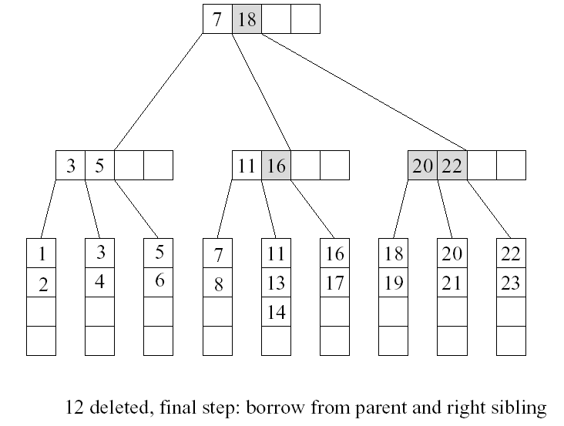
Cont’d

Slide 22
Deleting a key in an internal node
Case 3: all sibling v of u contains exactly ⎡M/2⎤ - 1 keys
Move the separating key between u and v in the parent of u and v down to v
Move the keys and child pointers in u to v
Remove the pointer to u at parent.

Slide 23
Example
Want to delete 5

Slide 24
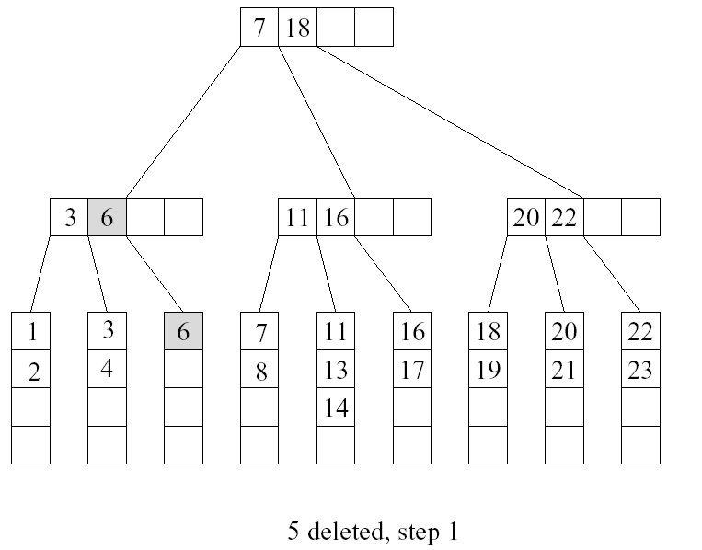
Example (Cont’d)
u
v

Slide 25
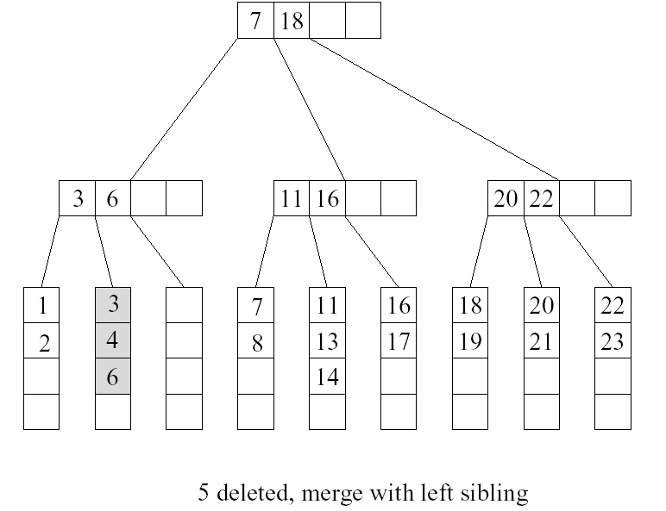
Example (Cont’d)

Slide 26
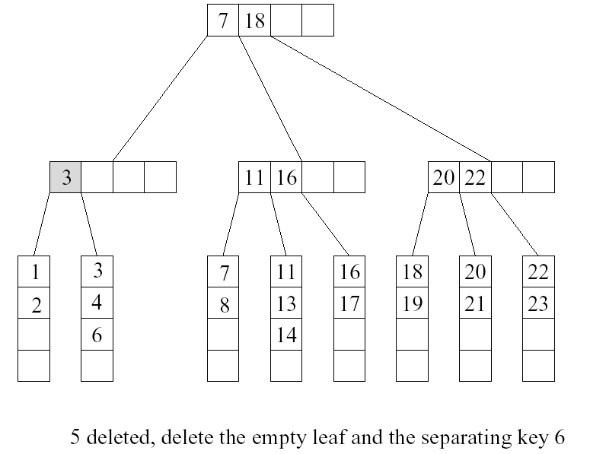
Example (Cont’d)
case 3
u
v

Slide 27
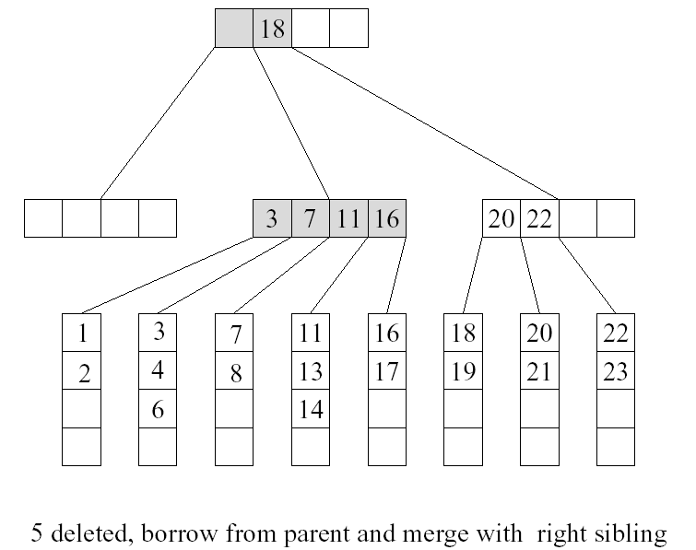
Example (Cont’d)

Slide 28
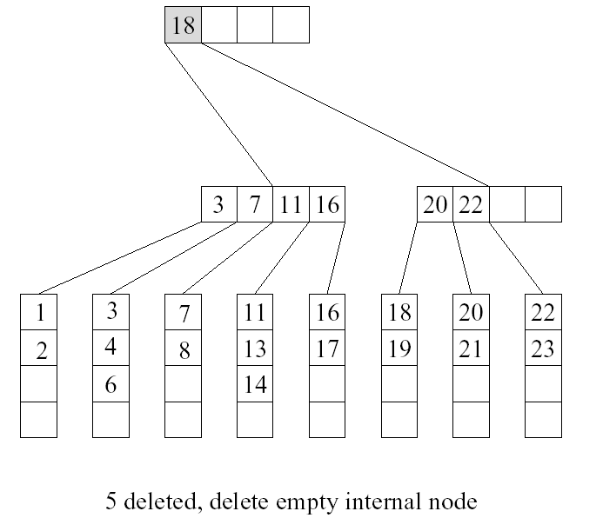
Example (Cont’d)

